Slide 1
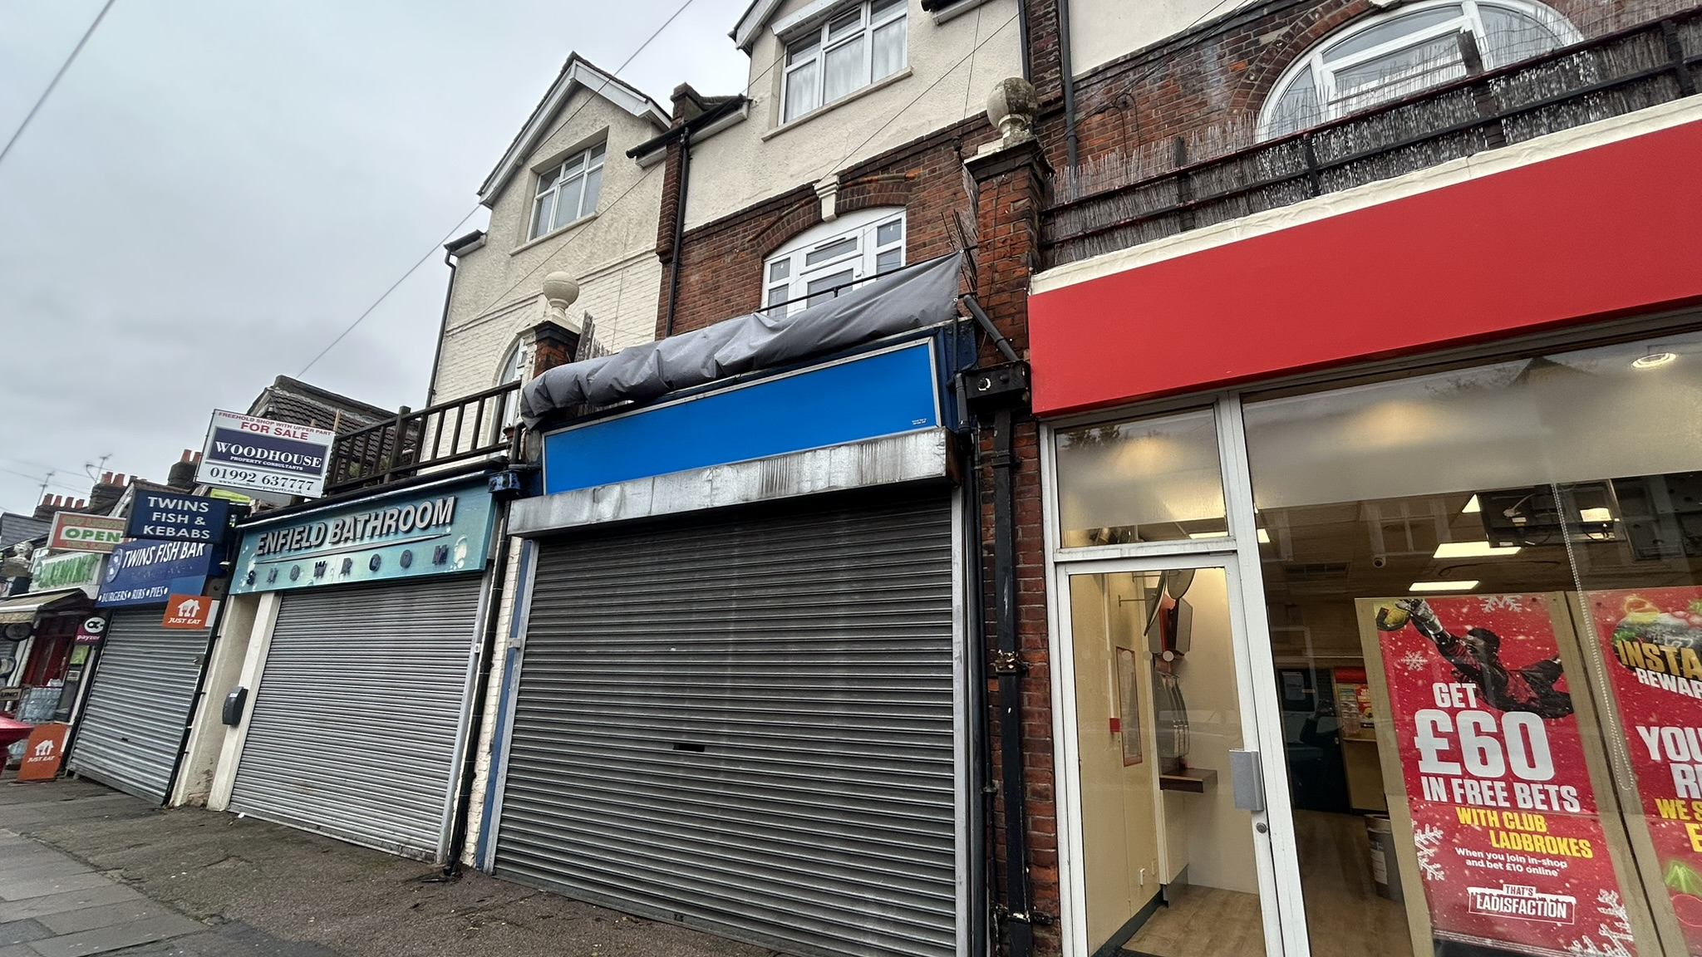
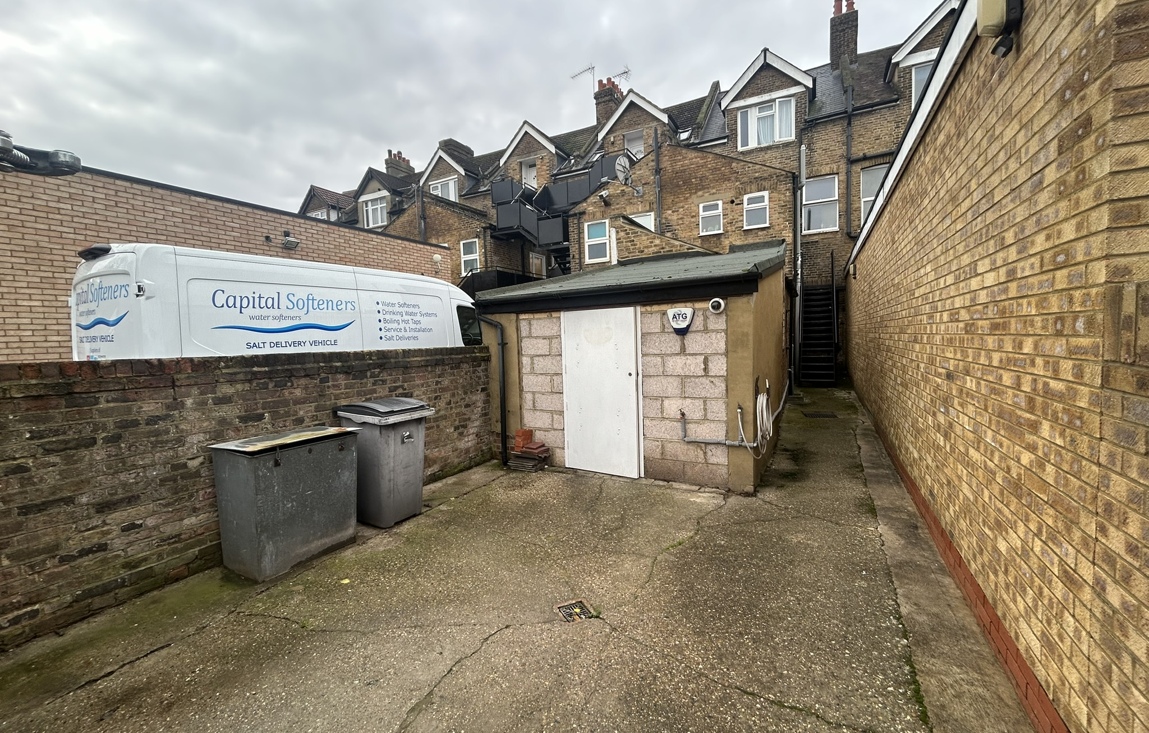
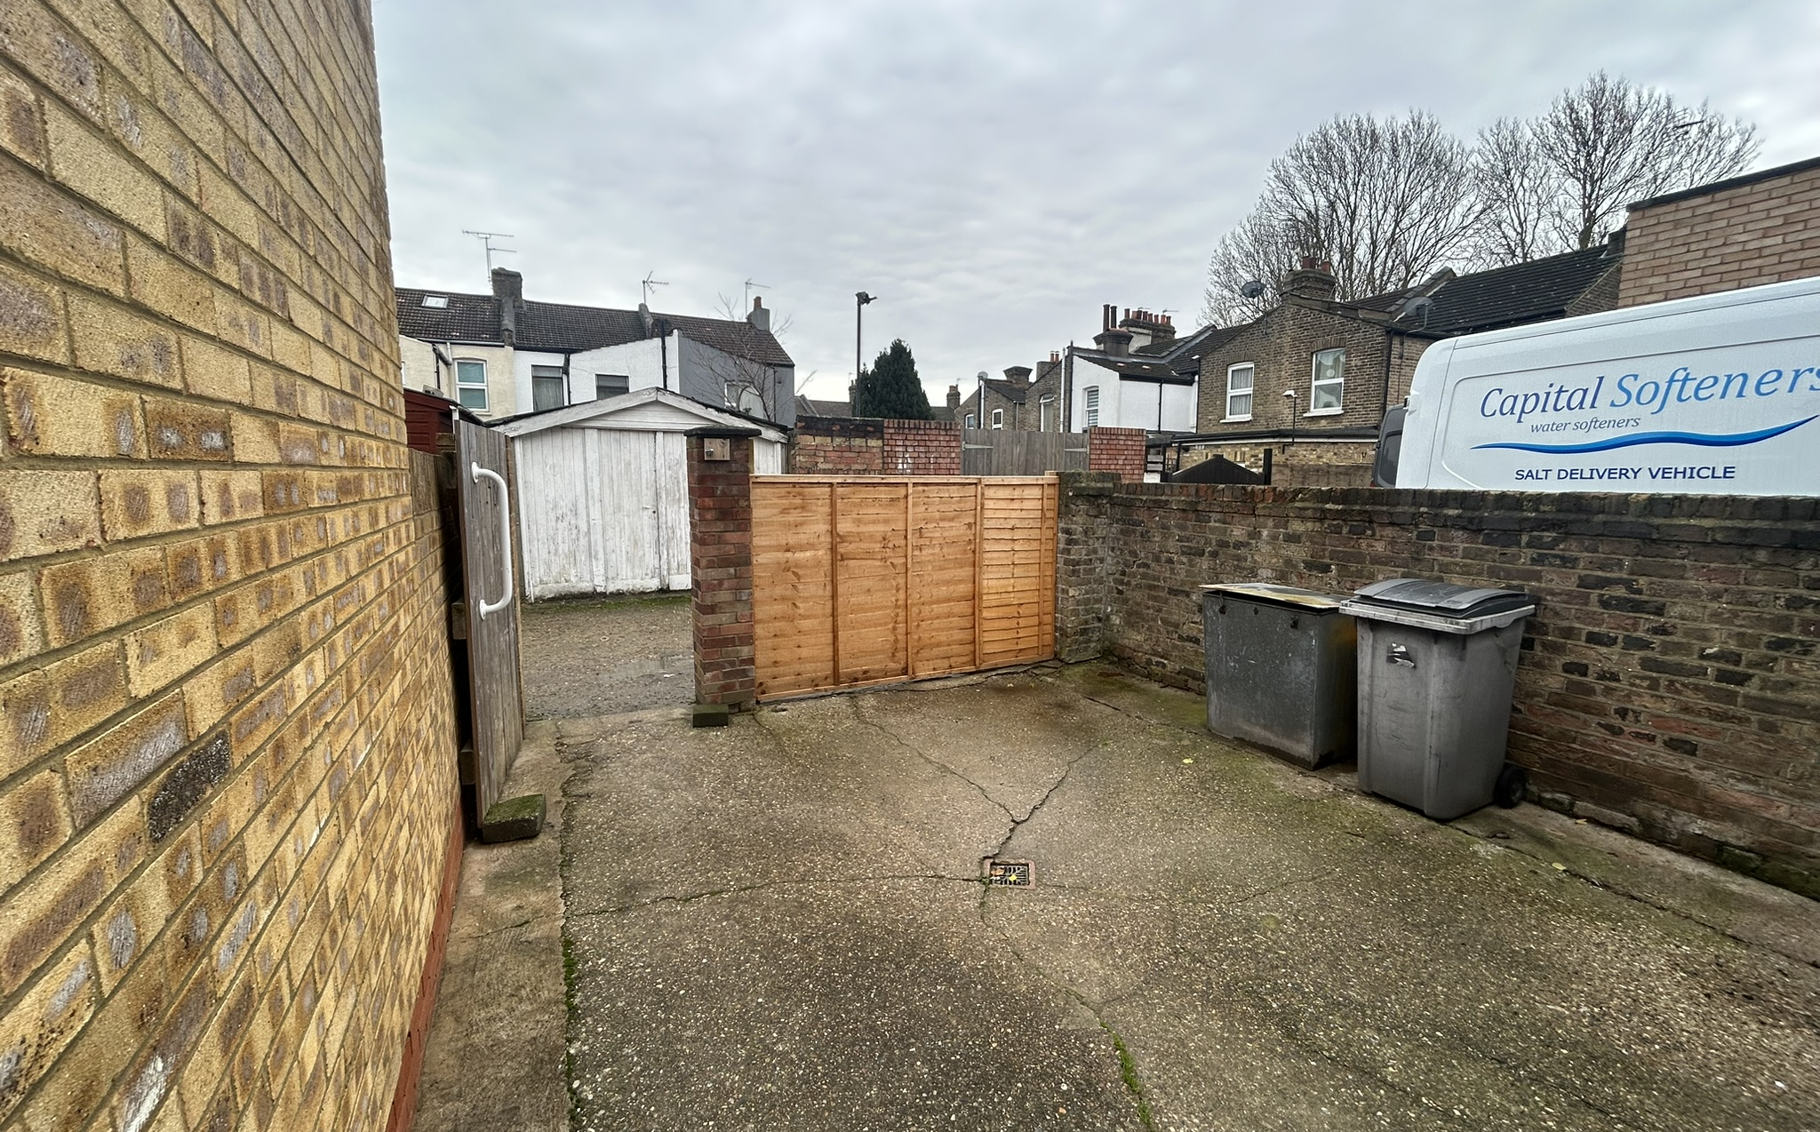
148 Percival Road,
Enfield, EN1 1QU
OIRO £16,000 pax
A self-contained lock-up retail unit to let situated on Percival Road, EN1 1QU, offering a prominent street-front location within a mixed-use parade close to Bush Hill Park Station. The shop provides approximately 81m² (871ft²) of sales and ancillary space. The property benefits from rear vehicular access together with yard.
Suitable for a variety of retail or service uses (subject to planning), the unit is offered with vacant possession, presenting an excellent opportunity for owner-occupiers or investors seeking a well-located neighbourhood retail premises.
81m2 (871ft2)
Use Class E
EPC D Rating

Slide 2
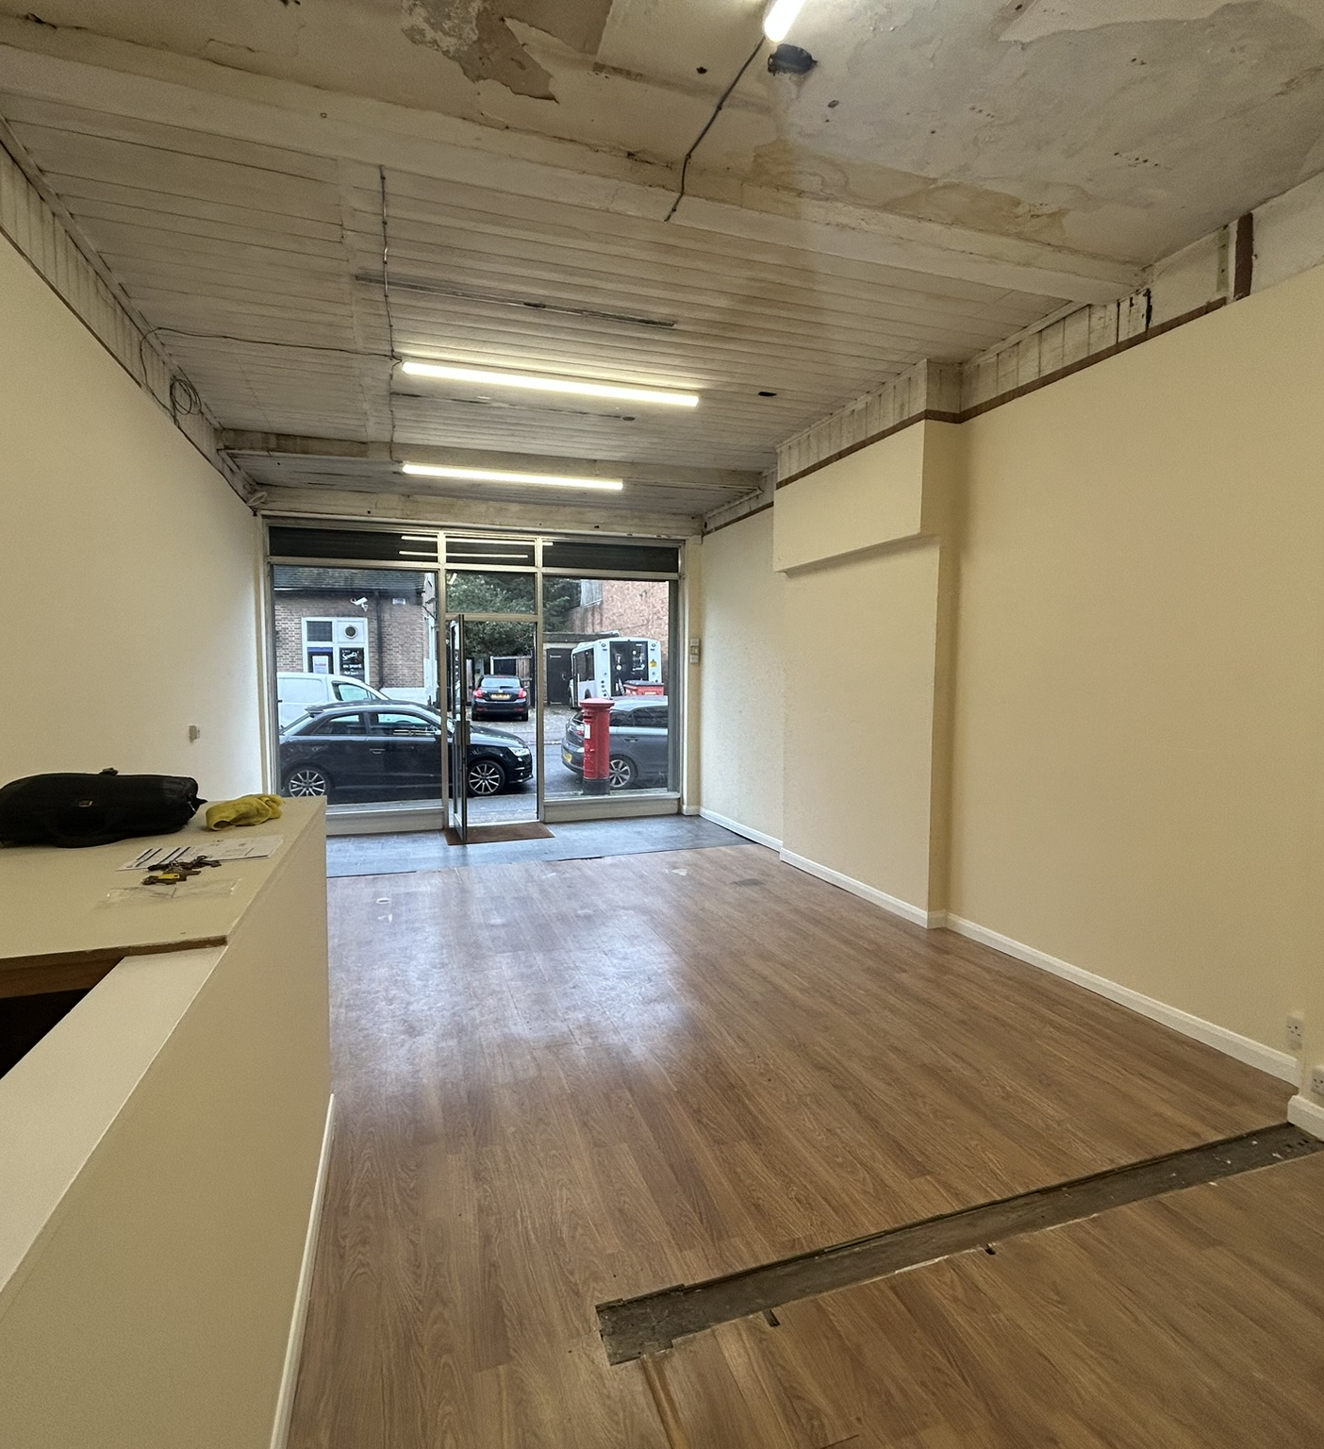
148 Percival Road, Enfield, EN1 1QU A self-contained lock-up retail unit situated on Percival Road, EN1 1QU, offering a prominent street-front location within a mixed-use parade close to Bush Hill Park Station. The shop provides approximately 81m² (871ft²) of sales and ancillary space. The property benefits from rear vehicular access together with yard. Accommodation: Ground Floor Sales: 40.40m² / 434.86ft² Ancillary / Storage: 20m² / 212.8ft² Basement Storage: 20.74m² / 223.24ft² Additional Garage/Store at rear Total NIA/GIA: 81m² / 871ft² Use Class: Class E Lease Type: FRI, New Commercial Lease Lease Term: To be negotiated. Rent: £16,000 per annum exclusive Rent Payment: To be negotiated Service Charge: Ad hoc Insurance: Landlord to insure, tenant to reimburse, fair proportion Business Rates: Rateable Value: £8,000 All applicants must make enquires with local authority as to rates payable. VAT: No applicable. Deposit: 3 -6 months rent, subject to references. EPC Rating: D 85 Parking: Unrestricted on Percival Road Utilities: Mains electricity, water and sewerage. No gas. Service Yard / Communal Areas: Yard to rear accessed by service road off Lincoln Road. Tenant of maisonette above has right of way by foot only to access entrance to property. Availability Date: Immediate Viewing Arrangements: By appointment with Williamson Dace Brown Contact: Thomas Dace 020 8886 4407 Thomas@wdbproperty.co.uk

Slide 3
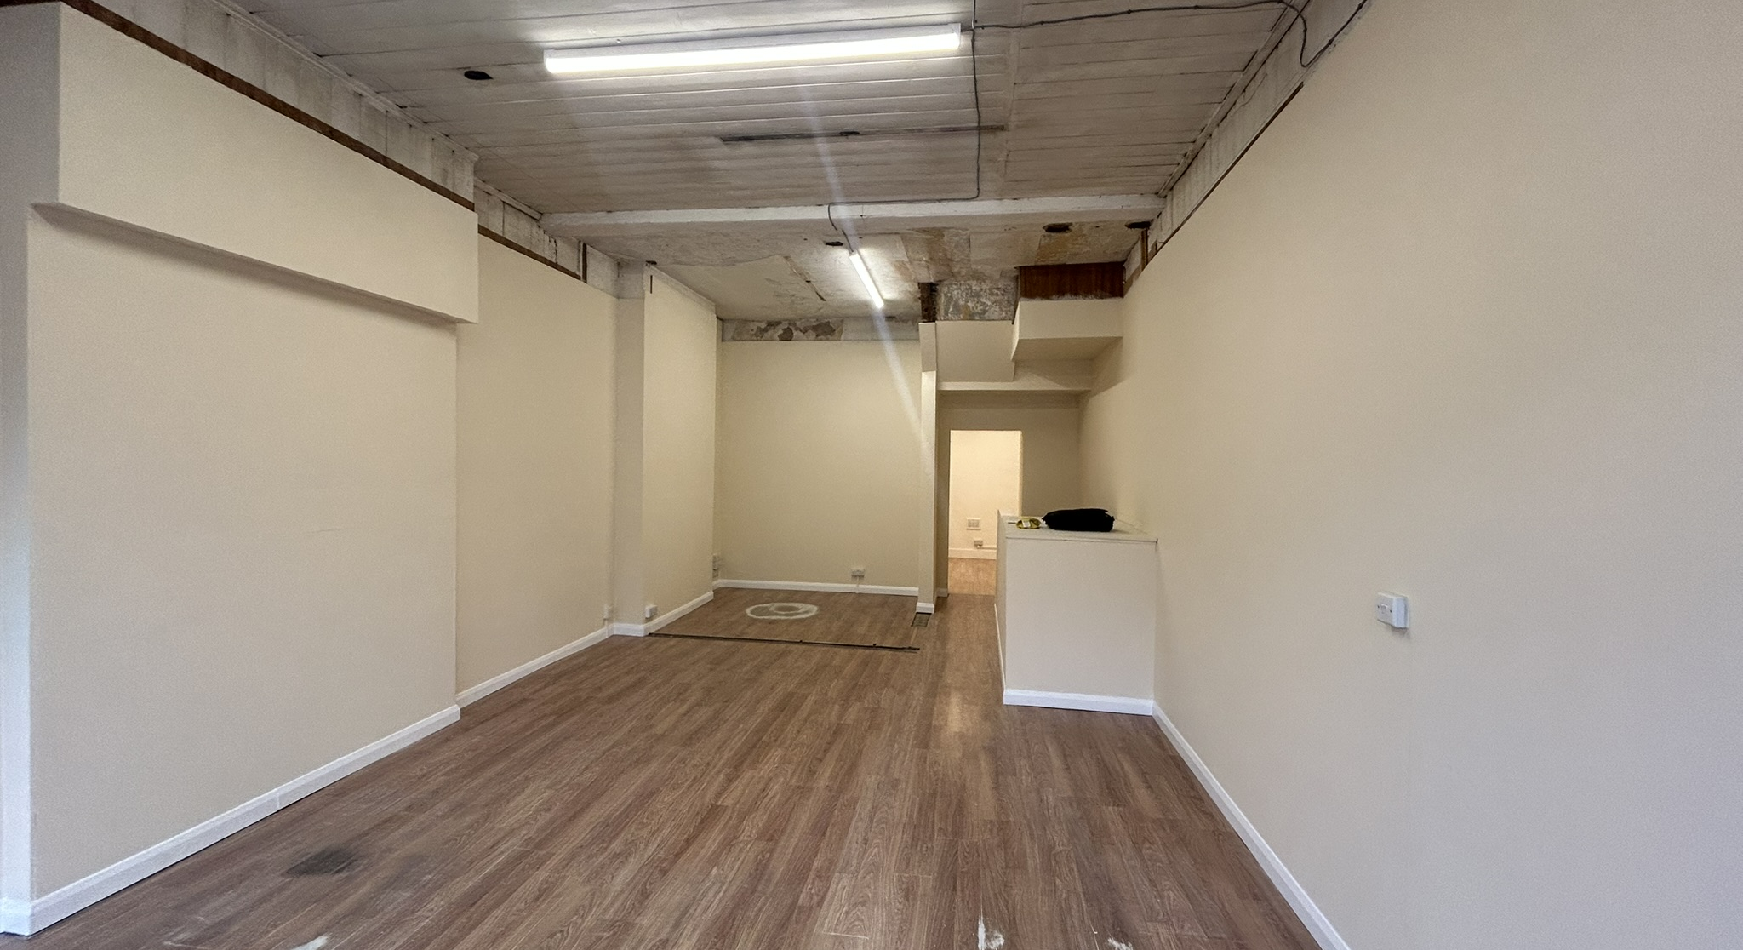
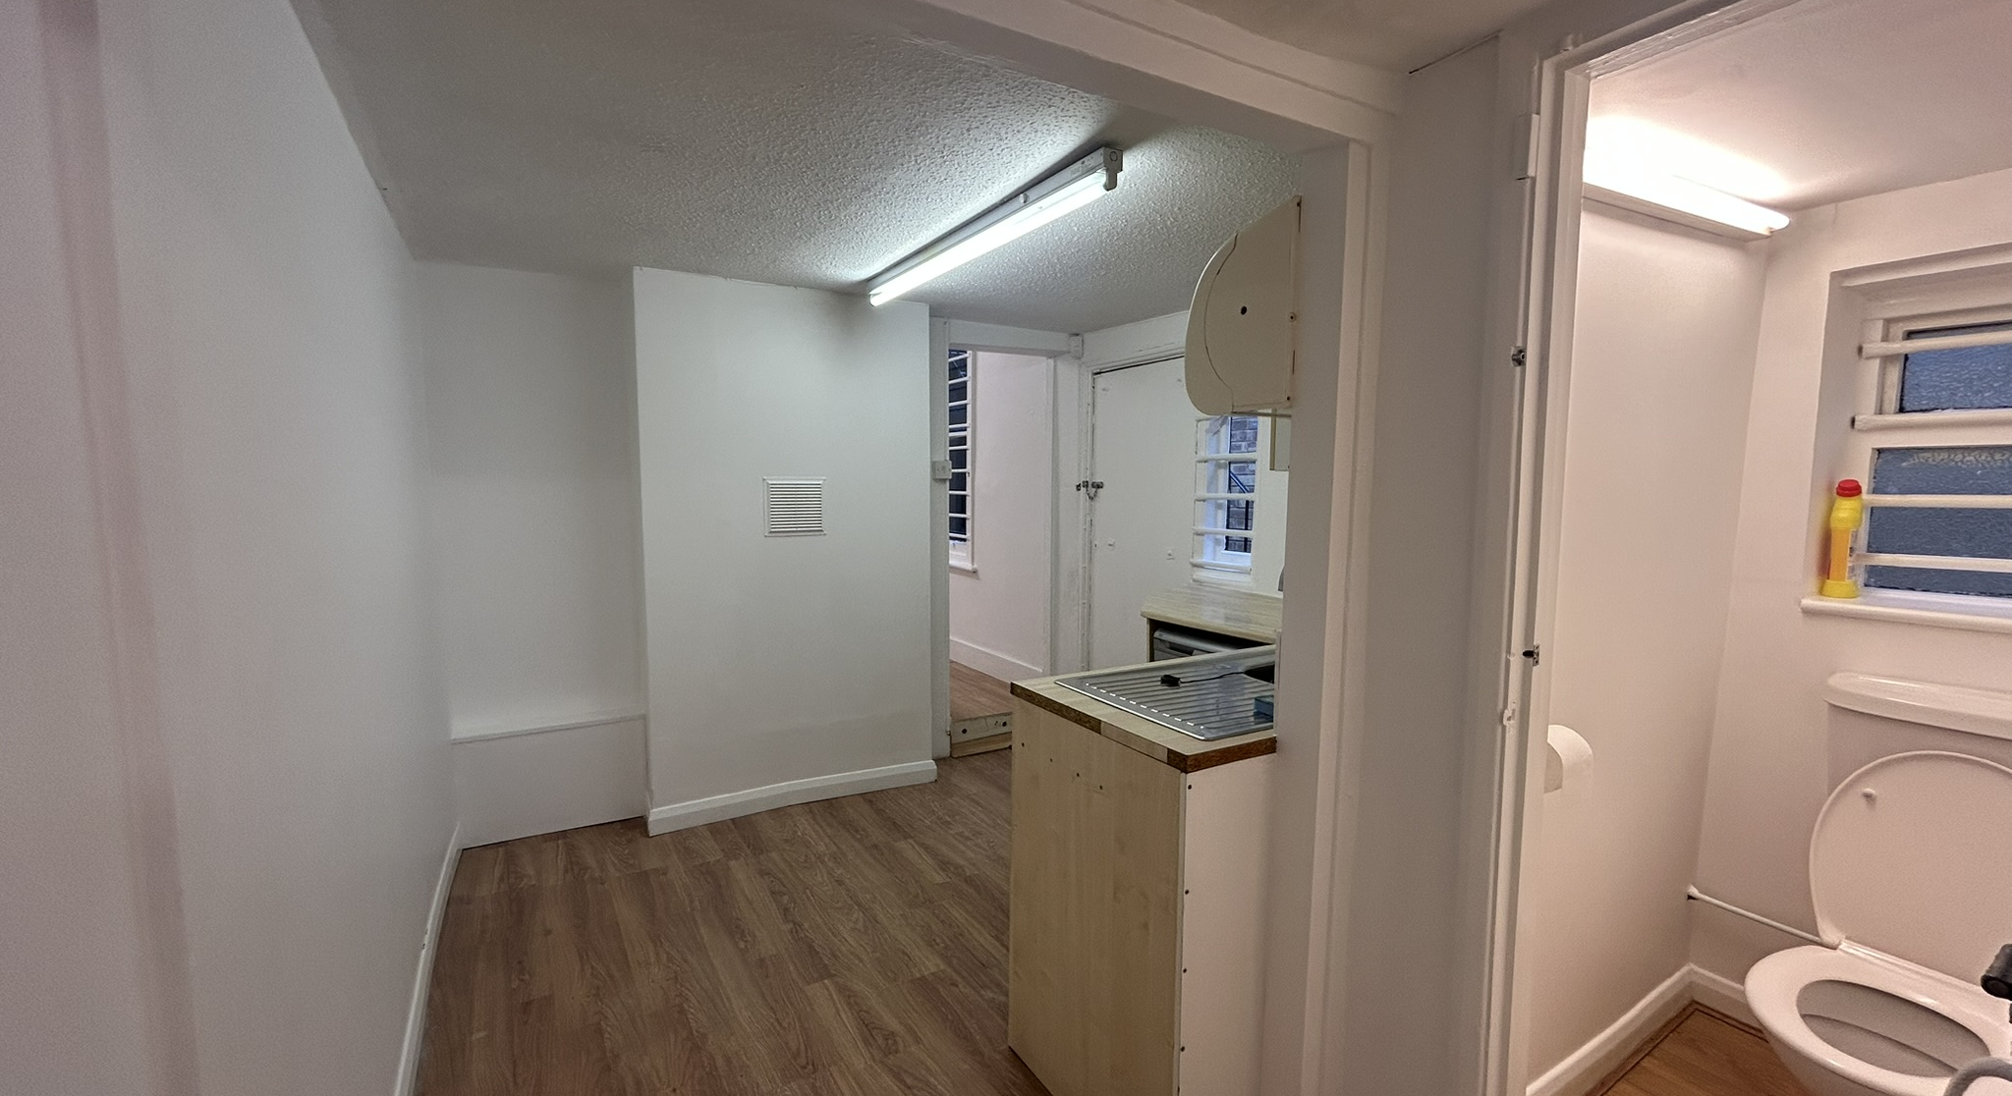
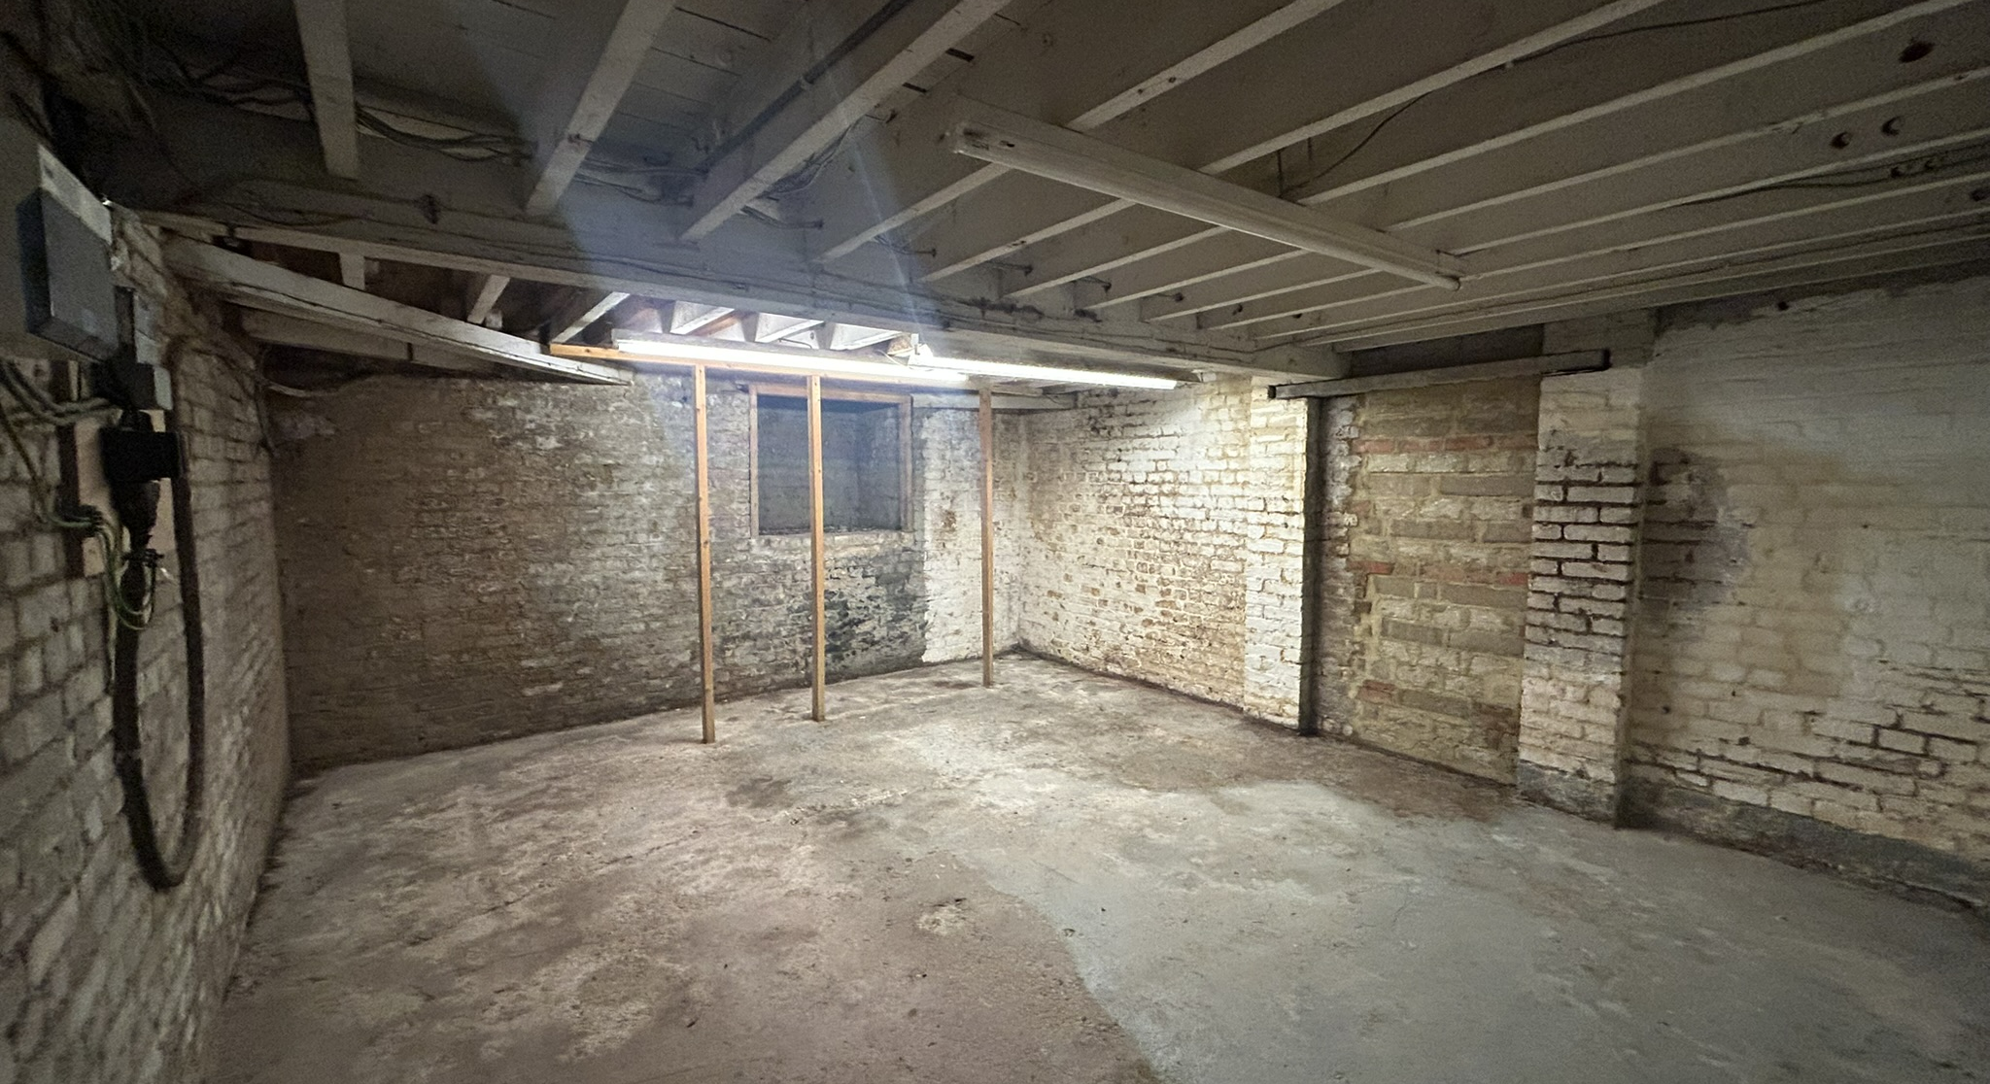
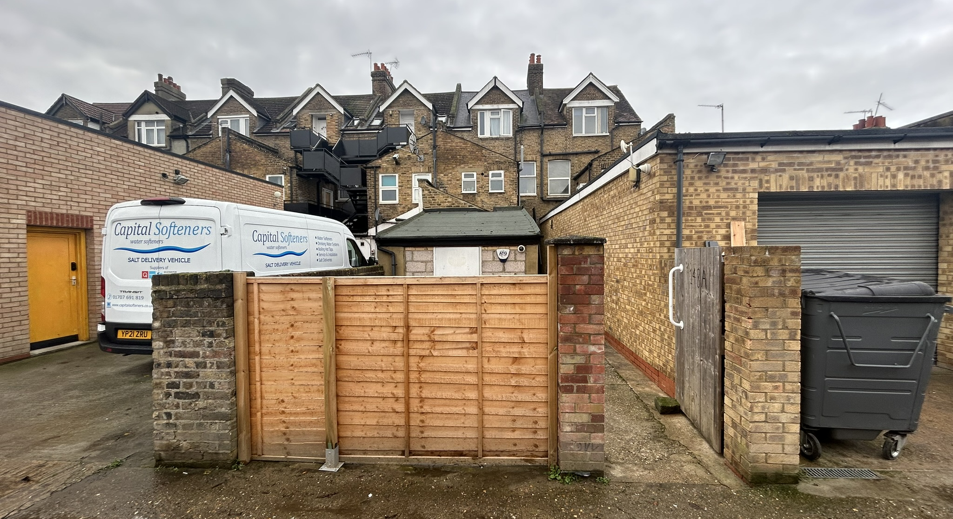

Slide 4
